Slide 1
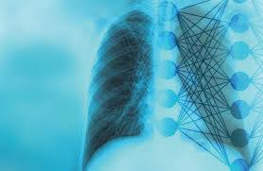
Welcome To Presentation On “PNEUMONIA PREDICTION USING X_RAY IMAGES” (CNN MODEL)
Developed by:
Bindu D P
Kavita L Kusagatti
Pooja G V
Sanskriti Kumar

Slide 2
Introduction
Pneumonia is a lung inflammation caused by a viral or bacterial infection that can range from mild to severe cases.
This inflammation makes the patient unable to breathe enough oxygen to reach the bloodstream.
It happens when an infection makes the air sacs (alveoli) in the lungs fill with fluid or pus that might affect either one or both lungs.
If your doctor thinks you might have pneumonia, a chest X-ray will be performed to find the infection in the patient's lungs and how far it’s spread.

Slide 3
Implementation
Before we start building the convolutional neural network, the following are the necessary libraries and dependencies.
from tensorflow.keras.models import Sequential #for initializing
from tensorflow.keras.layers import Dense #adding layers
from tensorflow.keras.layers import Conv2D #Convolution layer
from tensorflow.keras.layers import MaxPool2D #max pooling
from tensorflow.keras.layers import Flatten

Slide 4
Model development
So let’s jump into the code. The model that we are going to develop composes several components which are:
tensorflow.keras.layers.Conv2D(): The convolution layer which improves image recognition by isolate images features
tensorflow.keras.layers.MaxPooling2D(): a layer to reduce the information in an image while maintaining features
tensorflow.keras.layers.Flatten(): flatten the result into 1-dimensional array
tensorflow.keras.layers.Dense(): add densely connected layer
Additionally, before the model is fitted for training, it is necessary to configure the specifications as follows:
loss: pneumonia detection is using sigmoid activation in the final step, which resulted in either 0 or 1 (normal or pneumonia). Therefore, binary_crossentropy is the most suitable loss function
optimizer: RMSprop (Root Mean Square Propagation) with a learning rate of 0.001 will be used
metrics: accuracy is the measurement metric to obtain the prediction accuracy rate on every epoch

Slide 5
Code for implementation
model=Sequential()
model.add(Conv2D(32,3,3,input_shape=(64,64,3),activation='relu'))
model.add(MaxPool2D(pool_size=(2,2)))
model.summary()
Following is the output of model.summary().
Model: "sequential"
_________________________________________________________________________________________
Layer (type) Output Shape Param # ===========================================================================
conv2d (Conv2D) (None, 21, 21, 32) 896 ______________________________________________________________________________ ____________
max_pooling2d (MaxPooling2D) (None, 10, 10, 32) 0 _________________________________________________________________________________
flatten (Flatten) (None, 3200) 0 ============================================================================
Total params: 896
Trainable params: 896
Non-trainable params: 0

Slide 6
Model Training
Before the model is fitted for training, we are going to set up data generators to read images from source folders instead of labeling the image one by one. In basic concept, ImageDataGenerator labels images based on the directory the image is contained. This generator points to the sub-directory of the data. The code below can be described as below:
from keras.preprocessing.image import ImageDataGenerator
train_datagen=ImageDataGenerator(rescale=1./255,shear_range=0.2,horizontal_flip=True,zoom_range=0.2)
test_datagen=ImageDataGenerator(rescale=1./255)
x_train=train_datagen.flow_from_directory(r'C:\Users\User\internship\chest_xray\train',target_size=(64,64),batch_size=32,class_mode='binary')
x_test=test_datagen.flow_from_directory(r'C:\Users\User\internship\chest_xray\test',target_size=(64,64),batch_size=32,class_mode='binary')
#more than two categories class_model='categorical‘
The following is the output:
Found 5216 images belonging to 2 classes.
Found 624 images belonging to 2 classes.
The accuracy of the trained model reaches to 0.8980

Slide 7
Final prediction
Now the model is ready to make a prediction, in which the code below allows the user to input an image to determine whether the x-ray image is diagnosed with pneumonia.
from tensorflow.keras.models import load_model
import numpy as np
import cv2
model=load_model('mymodel1.h5')
pip install scikit-image
from skimage.transform import resize
def detect(frame):
try:
img=resize(frame,(64,64))
img=np.expand_dims(img,axis=0)
if(np.max(img)>1):
img=img/255.0
prediction=model.predict(img)
print(prediction)
print(model.predict_classes(img))
except AttributeError:
print("shape not found")
frame=cv2.imread(r"C:\Users\hp\internship\chest_xray\chest_xray\test\PNEUMONIA\person1685_virus_2903.j peg")
data=detect(frame)

Slide 8
Flask App code
from _future_ import division, print_function
import sys
import os
import glob
import numpy as np
from keras.preprocessing import image
from keras.applications.imagenet_utils import preprocess_input, decode_predictions
from keras.models import load_model
from keras import backend
import tensorflow as tf
global graph
tf.compat.v1.disable_eager_execution()
graph=tf.compat.v1.get_default_graph()
#global graph
#graph = tf.get_default_graph()
from skimage.transform import resize

Slide 9
# Flask utils
from flask import Flask, redirect, url_for, request, render_template
from werkzeug.utils import secure_filename
from gevent.pywsgi import WSGIServer
# Define a flask app
app = Flask(_name_)
# Model saved with Keras model.save()
model = tf.keras.models.load_model("prediction.h5")
# Necessary
print('Model loaded. Start serving...')
# You can also use pretrained model from Keras
# Check https://keras.io/applications/
#from keras.applications.resnet50 import ResNet50
#model = ResNet50(weights='imagenet')#model.save('')print('Model loaded. Check http://127.0.0.1:5000/')
@app.route('/', methods=['GET'])
def index():
# Main page
return
render_template('index.html')
@app.route('/predict', methods=['GET', 'POST'])
def upload():
if request.method == 'POST':

Slide 10
# Get the file from post request
f = request.files['file']
# Save the file to ./uploads
basepath = os.path.dirname(_file_)
file_path = os.path.join(basepath, 'uploads',
secure_filename(f.filename))
f.save(file_path)
img = image.load_img(file_path, target_size=(64, 64))
x = image.img_to_array(img) x = np.expand_dims(x, axis=0)
with graph.as_default():
preds = model.predict_classes(x)
#index = ['No Tumor','Yes Tumor']
#text = "prediction : "+[preds[0]]
if preds[0][0]==0:
prediction="Normal"
else:
prediction="Pneumonia"
text = "prediction : "+prediction
# ImageNet Decode
return text
if _name_ == '_main_':
app.run(debug=False,threaded = False)

Slide 11
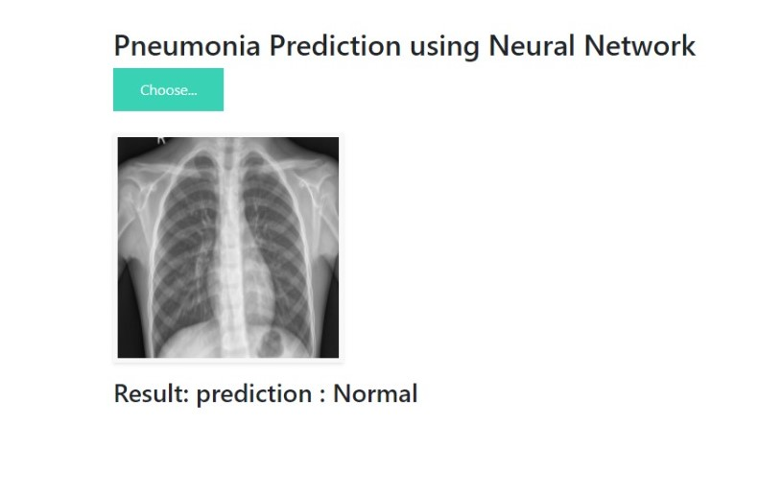
Outputs for the prediction

Slide 12
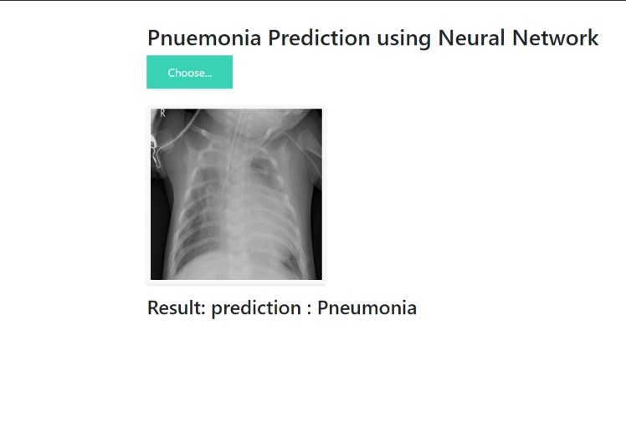

Slide 13
CONCLUSION
Throughout the process of developing the CNN model for Pneumonia prediction, we have built a model from scratch which consists of 5 layers and follows with a fully connected neural network. Then the trained model is evaluated using separate unseen data to avoid bias prediction. As the result, the accuracy of the test dataset reached 81.25% which indicates a decent model. This mini-project allows a beginner to obtain an overview of how to build a model to solve a real-world problem.

Slide 14
THANK YOU

